Slide 1
Diversity and Disability in Guernsey
Guernsey Disability Alliance (GDA)
Equality Guernsey
States Disability Officer

Slide 2
Introduction to Diversity
Equality Guernsey

Slide 3


Slide 4
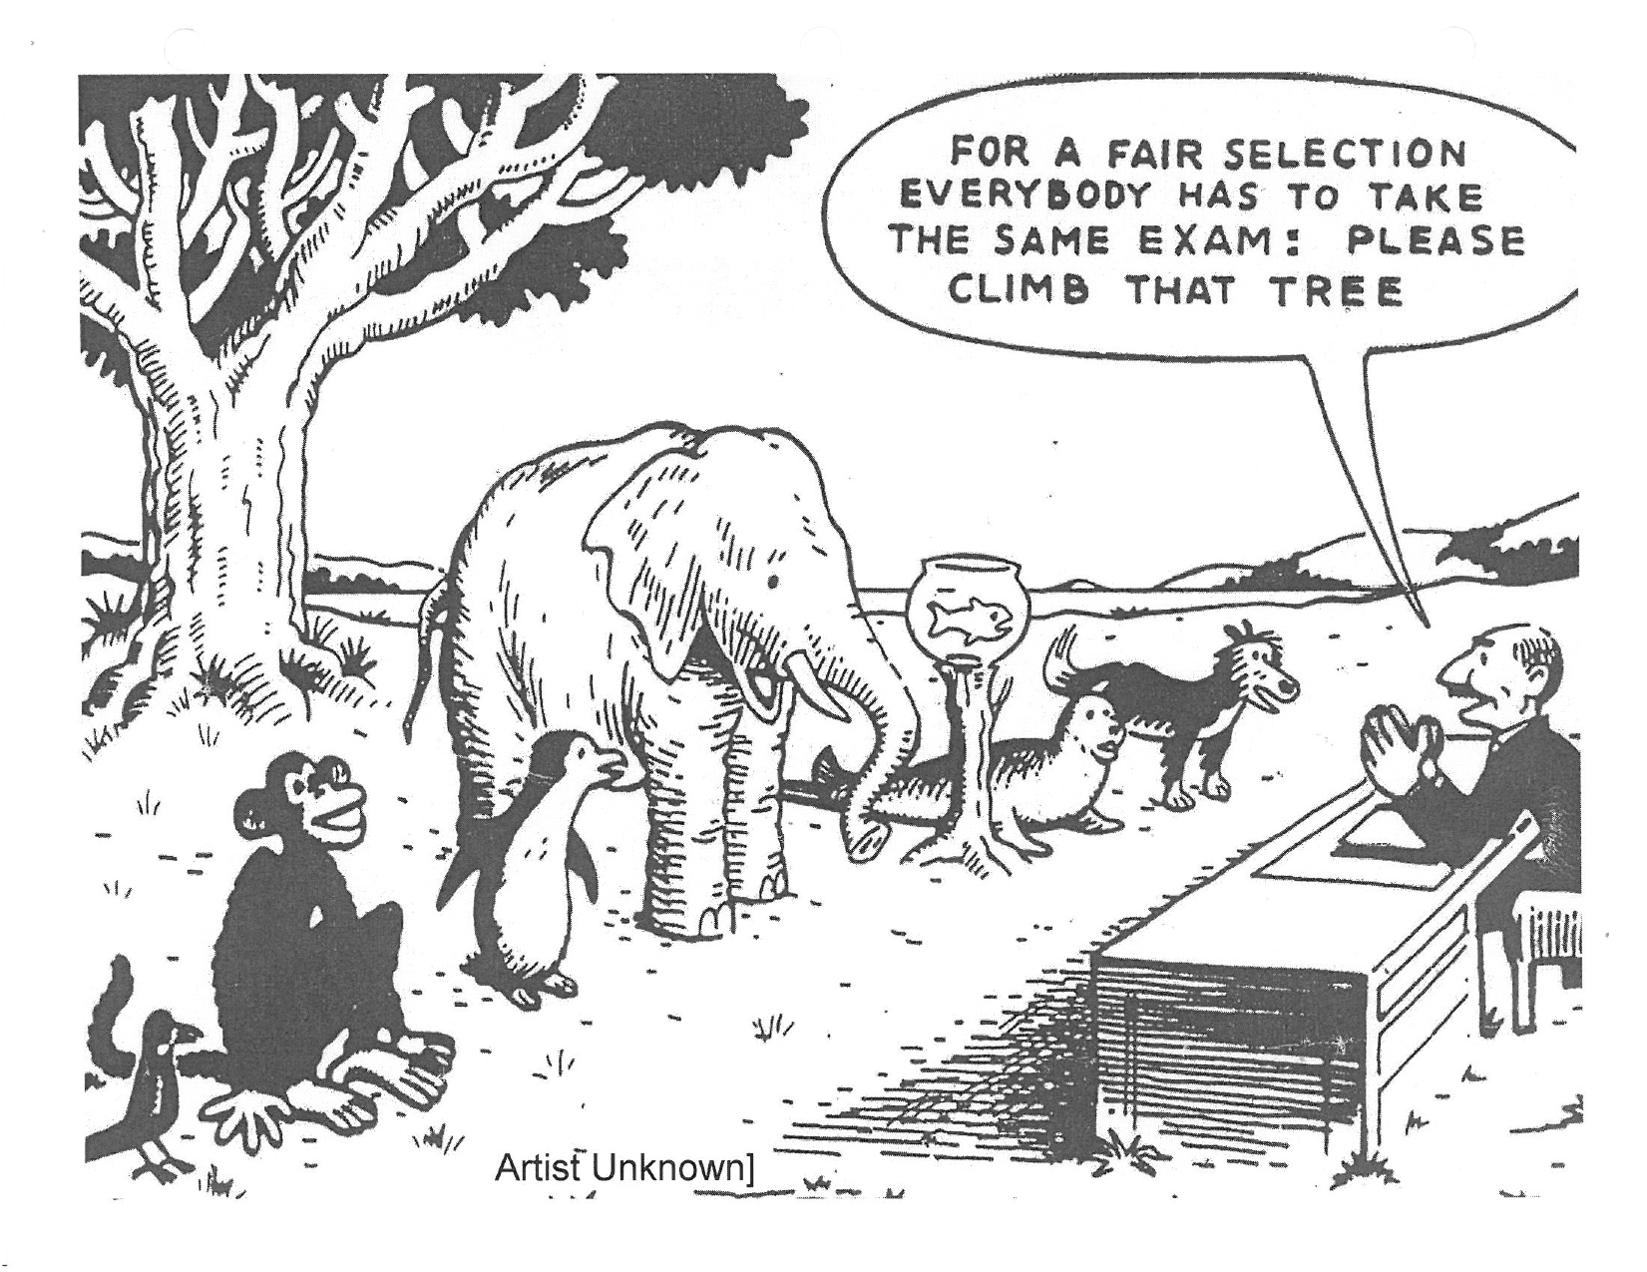
Diversity
Diverse is another word for different.
Diversity is having a range of differences within a group.

Slide 5
Diversity
In humans this might mean diversity based on:
Social category - such as age, race, wealth
Information - such as education, knowledge
Values - such as attitudes, personality, belief

Slide 6
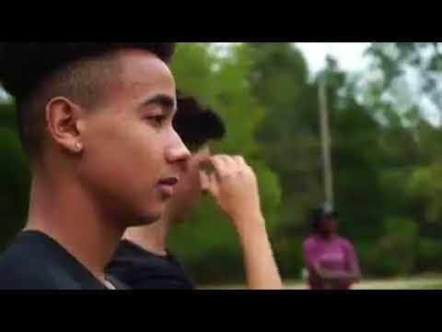
Video
Notes:
https://youtu.be/4K5fbQ1-zps

Slide 7
Diversity activity
A lot of the time we think of diversity in terms of just
social categories or ‘protected characteristics’ but there are a large range of areas where difference can occur.
Can you think of 5 examples of what can makes us
different / diverse from other people?
ALLOW ANSWER FOR 5 EXAMPLES

Slide 8
Did your list include these examples*?
Politics
Religion
Profession
Marital status
Experiences
Viewpoints
Backgrounds
Life experiences
Age
Race
Sex
Ethnicity
Socioeconomic status
Gender
Exceptionalities
Language
Religion
Sexual orientation
Geographical area
Economics
Philosophy
*this list is not exhaustive

Slide 9
How diverse is Guernsey
What % of the population aren’t born in Guernsey
47%
UK
  – 25%
European
  – 6%
Rest of world
  – 4%
Unknown - 12%
Source: States of Guernsey digest

Slide 10
Diversity within the community
How many young people identify as LGBTQ+
  18% (Children and Young People Survey)
What number of the population have a disability / impairment
  13,500 and 4,000+ carers (Disability Needs Survey 2013)
How people have Mental Health Issues
  1 in 4 – (wellbeing survey)
Ethnicity – no figures
Aged over 70
  14% of which 56% are women

Slide 11

Notes:
https://www.youtube.com/watch?v=dVp9Z5k0dEE

Slide 12
Where does bias come from?
Notes:
https://specsavers.wistia.com/medias/wg2kw3yfdr -PLAY VIDEO

Slide 13
We unconsciously assign positive and negative value to the categories we use
We instinctively categorise people and things using easily observed criteria such as age/weight/skin colour/gender /ability or disability / tattoo's / piercing’s / facial hair
….automatically assigning presumed traits to anyone we subconsciously put into groups!

Slide 14
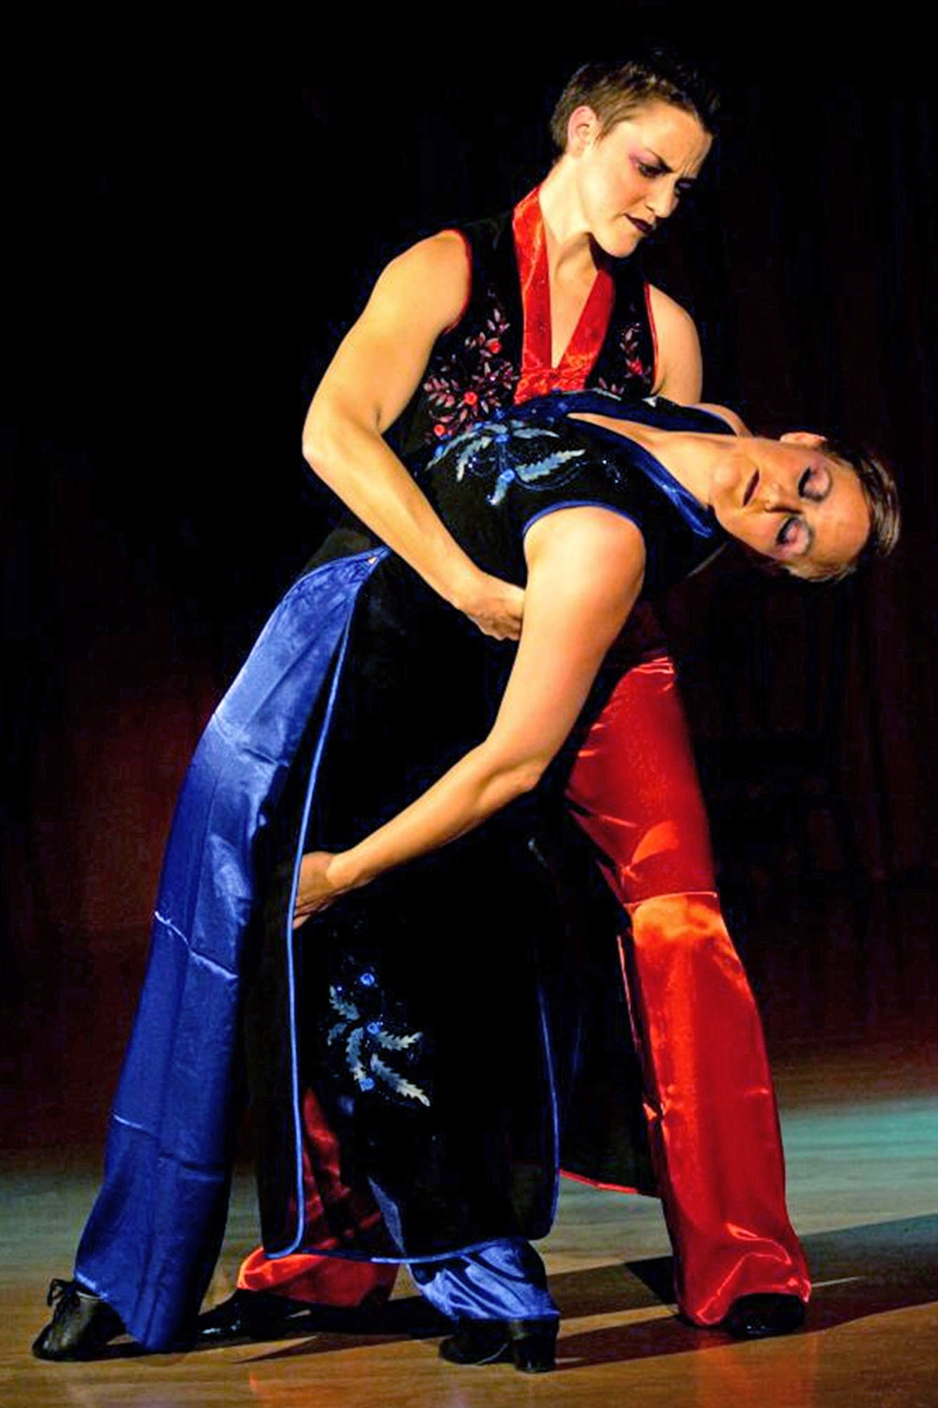
Inclusion
“Diversity is being invited to the party, inclusion is being asked to dance”
Verna Myers, D&I Professional
We all like to think of ourselves as inclusive, easy-going, non-prejudiced people. If this were a reality, there would be no discrimination.
So, why do we exclude people?

Slide 15
Introduction to Disability
Gill Evans - Disability Officer SoG

Slide 16

States Disability Officer

Slide 17

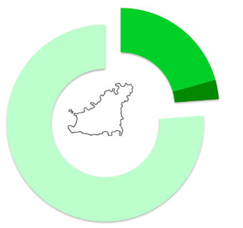
Purple Pound in Guernsey £274,000,000
Source: Disability Needs Survey 2013
Notes:
– which is worth £274 billion in the UK (and is rising by an average of 14% per annum)

Slide 18
Diversity of Disability

Slide 19
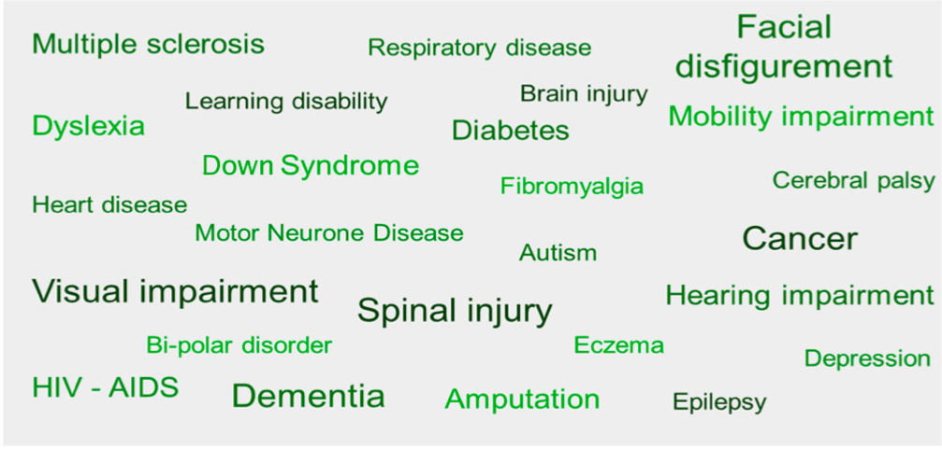
Diversity of Disability

Slide 20
Barriers

Slide 21
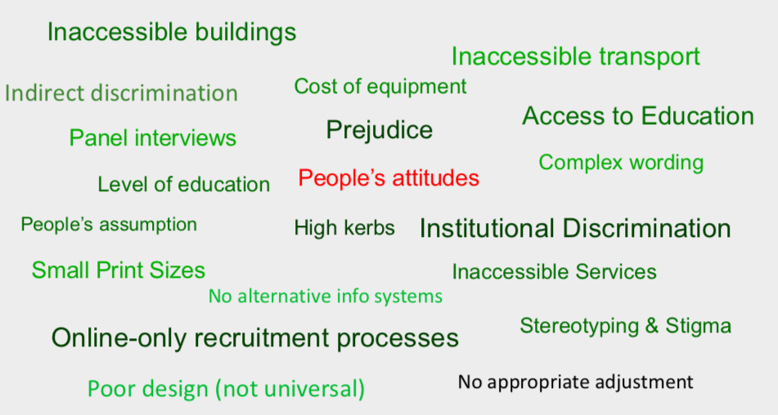
Barriers

Slide 22
Introduction to the Equality legislation proposals
Employment and Social Security

Slide 23

Notes:
So what is discrimination legislation? Essentially it is about ensuring that everyone can get equal and non-discriminatory access to work, education, housing and services – like shops, the cinema, the hospital, and so on.

Slide 24











Phase 1
Phase 2
Disability
Age
Sex
Carer
status
Pregnancy & maternity
Race
Marital status
Sexual
orientation
Gender reassignment
Religious Belief
Notes:
In Guernsey at the moment, our existing legislation only protects people from discrimination at work on the grounds of sex (including pregnancy), gender reassignment (which protects trans people) and marriage.
In July of this year, the States agreed to the preparation of a new Discrimination Ordinance in two phases. Discrimination on the grounds of disability, carer status will be outlawed as part of the first phase, which is expected to come into force in 2022 and will be much wider than just employment covering access to good and services, education, accommodation and membership of clubs and associations.

Slide 25
Types of unlawful discrimination | Other prohibited conduct
Direct discrimination | Harassment
Discrimination by association | Sexual harassment
Discrimination arising from disability | Discriminatory advertisements
Indirect discrimination | Victimisation
Denial of a reasonable adjustment | Instructions or pressure to commit a prohibited act
 | Failing to provide equal pay for equal work
Notes:
The Ordinance will prohibit five main types of discrimination, as well as prohibiting conduct such as harassment, sexual harassment and victimisation.

Slide 26
Why is this legislation so important for disabled persons?
It will prohibit less favourable treatment of disabled persons and unpaid carers (and other groups).
It will require employers and providers of goods and services to consider the impact of policies and procedures on disabled people and unpaid carers (and other groups) and eliminate or minimise those impacts.
It will introduce a duty on employers, providers of goods or services, accommodation providers and clubs and associations to provide ‘reasonable adjustments’ when requested by a disabled person.
It will hopefully lead to improved awareness and consideration of the needs of disabled people.
Notes:
So, why is this legislation so important for disabled persons?
Firstly, it will prohibit less favourable treatment of disabled persons and their unpaid carers.
It will require employers and providers of goods and services to consider the impact of policies and procedures on disabled people and unpaid carers (and other groups) and eliminate or minimise those impacts.
It will introduce a duty on employers, providers of goods or services, accommodation providers and clubs and associations to provide ‘reasonable adjustments’ when requested by a disabled person (and not a disproportionate burden).
It will hopefully lead to improved awareness and consideration of the needs of disabled people.

Slide 27
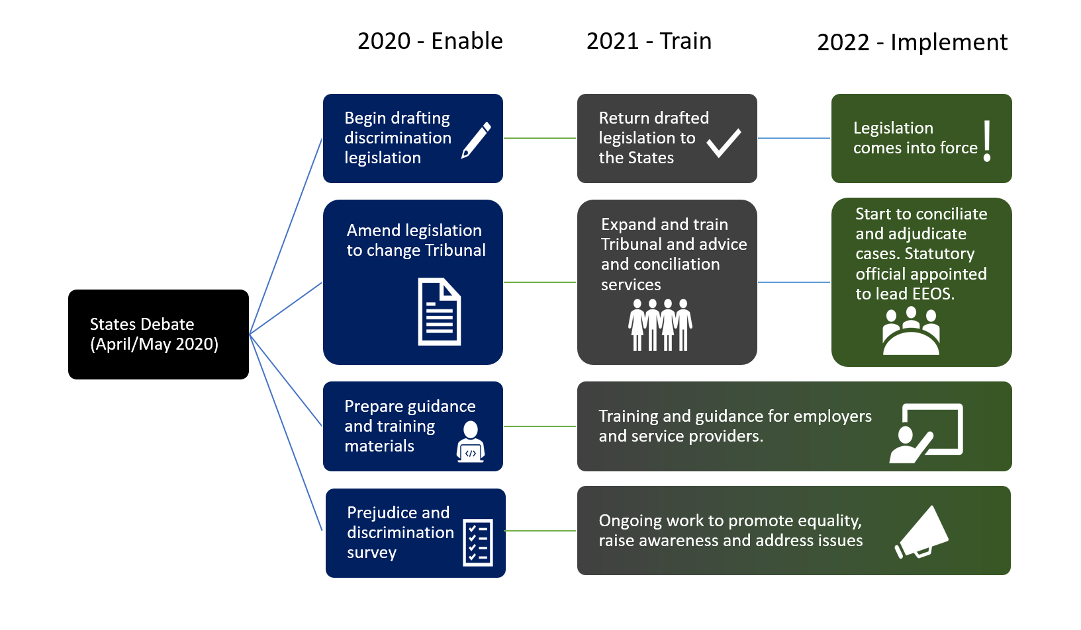
High-level Implementation Plan
2021
2022
States Debate
Apr 2020
Became July 2020
Additional policy letter on religious belief and sexual orientation
Notes:
There is a great deal of work required to make this all happen, both some further policy work and project implementation.
This diagram shows how Phase 1 will be implemented.
Work has already begun on the drafting of the legislation.
Guidance and training for employers and service providers on their future new responsibilities will be provided before the legislation comes into force in the second half of 2021.
While a date has not been set for when the legislation will come into force, it is anticipated that this would be during 2022, if all goes to plan, so businesses and organisations will have time to prepare. Originally we were hoping for April 2022, but delays in debate due to Covid-19 and the rescheduling of the General Election may mean that the implementation date is later in 2022.

Slide 28
Disability Etiquette
Notes:
respectful communication and interaction with people who have disabilities

Slide 29
Why is it important?
Help people feel more comfortable when interacting with disabled people
Can help prevent awkward situations
Expand business opportunities – good customer service
Serve customers more effectively
Basically
To treat the disabled person as you would treat anyone else

Slide 30
Top tips: people first language
Recognises the person not the disability.
  Person who is blind, NOT the blind
  Person who is hard of hearing NOT suffering a hearing loss
  Person with a physical disability NOT crippled, lame or deformed
  Person who is successful, productive NOT someone who has overcome their disability
  Person who uses a wheelchair NOT wheelchair bound
Notes:
recognizes that individuals are more than their disabilities

Slide 31
More top tips
Don’t ask questions about a person’s disability unless it is brought up by the individual.
If you offer assistance, wait until the offer is accepted. Then listen to or ask for instructions.
Speak directly to the person.
Don’t be afraid to ask questions when you are unsure of what to do.
When introduced to a person with a disability, it is appropriate to offer to shake hands.
Treat adults as adults.
Notes:
Shake hands:
People with limited hand use or who have artificial limbs can usually shake hands. (Shaking hands with the left hand is also an acceptable greeting.)
Adults as adults: Address people who have disabilities by their first names only when extending the same familiarity to all others.

Slide 32


Hidden Disabilities Lanyard
If you see someone wearing a Hidden Disabilities
Lanyard (or a badge) just say:
How can I help you?
Make them feel at ease
Speak clearly and slowly
Explain in simple and easy language
Be patient
Listen to them
Notes:
https://matter.gg/purple-tuesday-2019/hidden-disabilites/

Slide 33
Autism and Asperger’s
Stick to clear facts rather than providing information which needs interpreting.
For example: “we have this jumper in red, navy and black” rather than “we have this jumper in lots of colours.”
Notes:
Guernsey

Slide 34
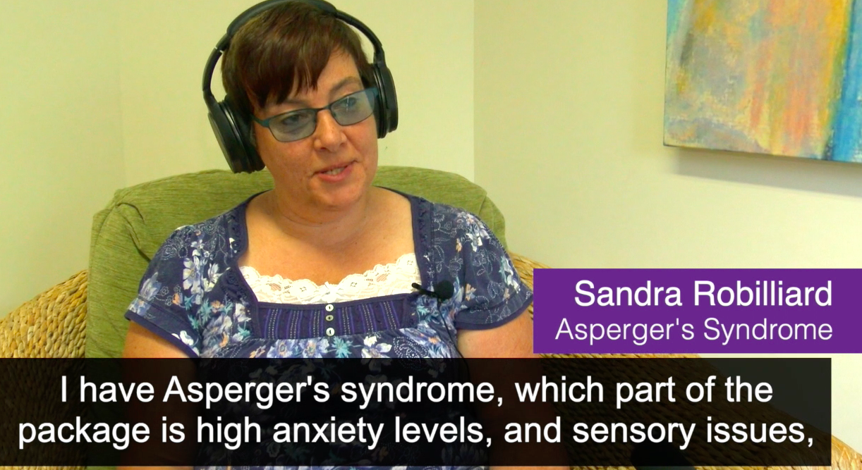
Sandra’s videos
Notes:
Understanding the condition - https://youtu.be/WobenoOeSIM
Eating out - https://youtu.be/VIB28lX4NVU
Improving the shopping experience - Sound hints and tips - https://youtu.be/geYgc1NlLoU
Improving the shopping experience - Visual hints and tips - https://youtu.be/0noHFG6I0mk

Slide 35
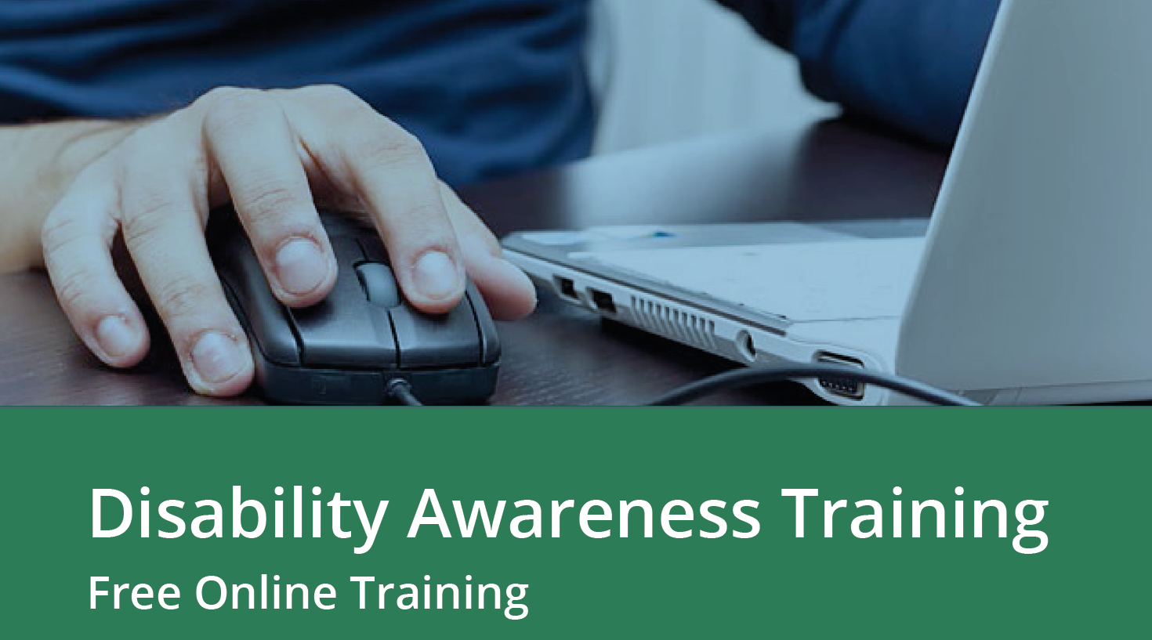
6 Modules
Different impairments/ disabilities
Practical advice about helping people with different disabilities
Why it is important to use
the correct language
to describe disability.

Slide 36

Co-Operative Society

Slide 37
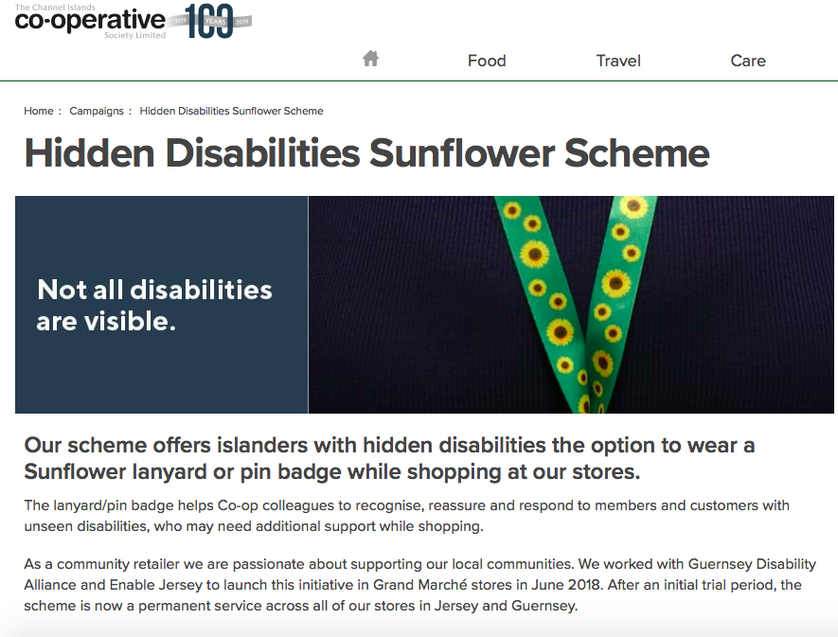
Co-Operative Society

Slide 38
We would welcome your feedback
Notes:
https://youtu.be/4K5fbQ1-zps

