Slide 1


Slide 2

* Welcome
* 2022
* Guest Speaker: Adrian Sarchet
* Close
We welcome members, partners and supporters to our end of year event

Slide 3
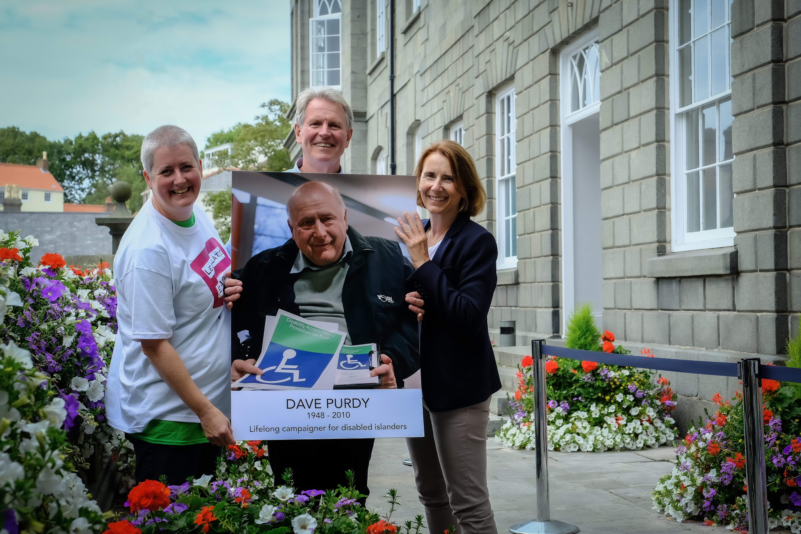
“A lot of people are waiting for Martin Luther King or Mahatma Gandhi to come back – but they are gone. We are it. It is up to you”
Marian Wright Edelman
Notes:
Kerstin

Slide 4
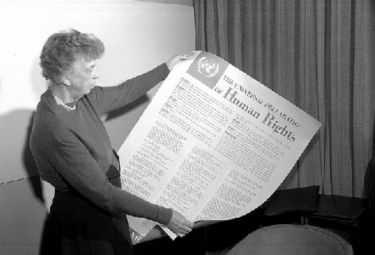
Human Rights in small places
“Where, after all, do universal human rights begin? In small places, close to home – so close and so small that they cannot be seen on any maps of the world. … Unless these rights have meaning there, they have little meaning anywhere. Without concerned citizen action to uphold them close to home, we shall look in vain for progress in the larger world.”
Eleanor Roosevelt
Notes:
Women Who Shaped the Declaration
Women delegates from various countries played a key role in getting women’s rights included in the Declaration. Hansa Mehta of India (standing above Eleanor Roosevelt) is widely credited with changing the phrase "All men are born free and equal" to "All human beings are born free and equal" in Article 1 of the Universal Declaration of Human Rights.

Slide 5


Slide 6
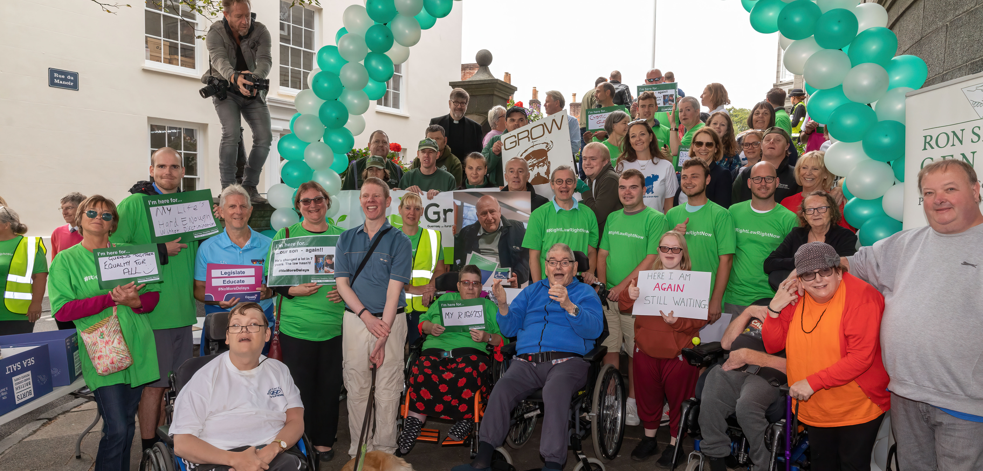

Slide 7
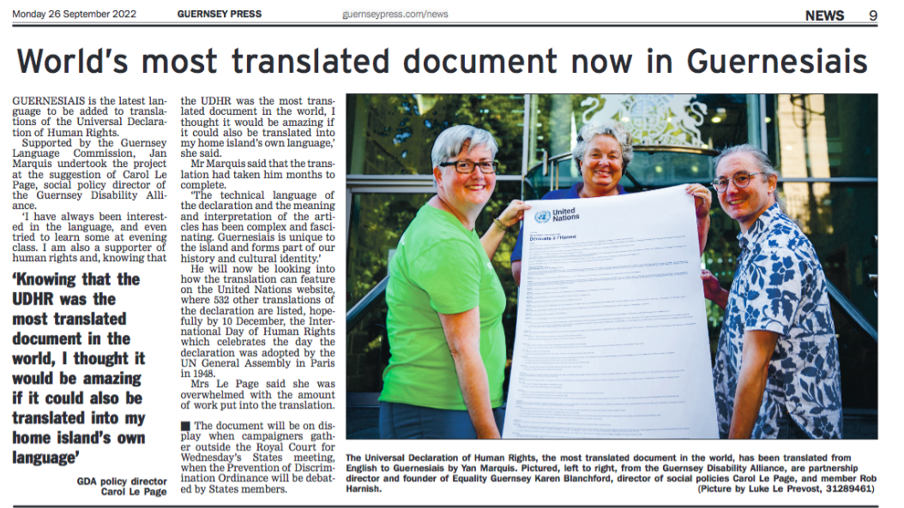
UDHR Guernesiais
Notes:
Universal Declaration of Human Rights has been translated in more than 80+ languages
As of September 2022, that now includes Guernesiais, thanks to the Guernsey Language Commissions Jan Marquis

Slide 8
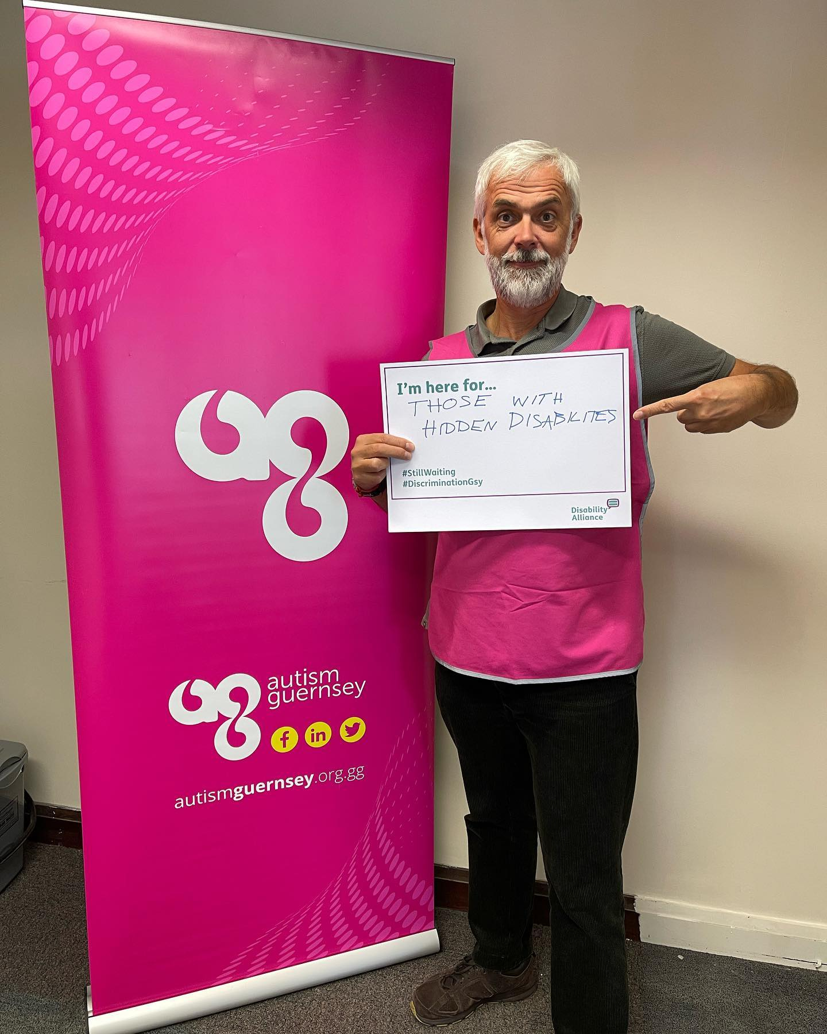
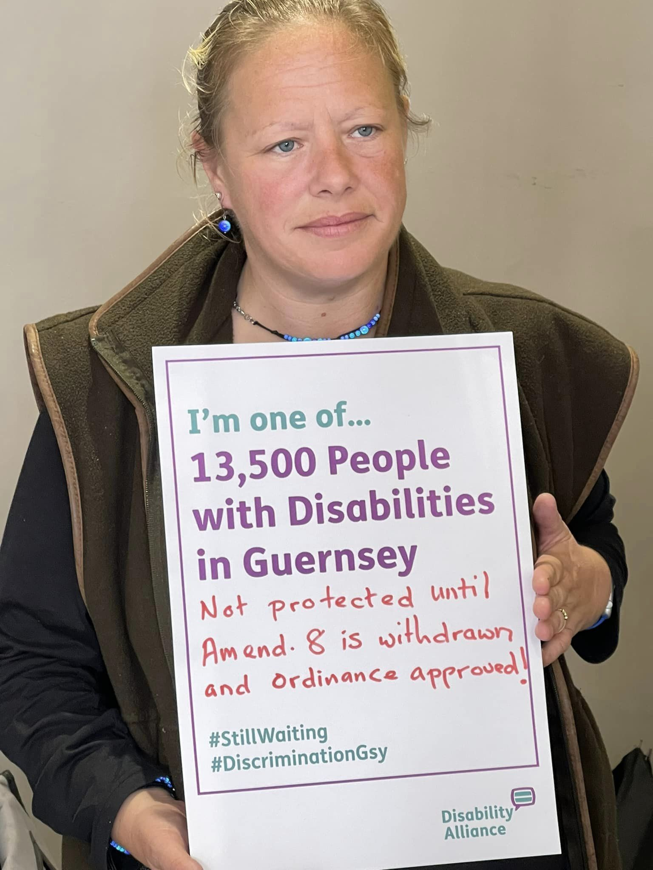
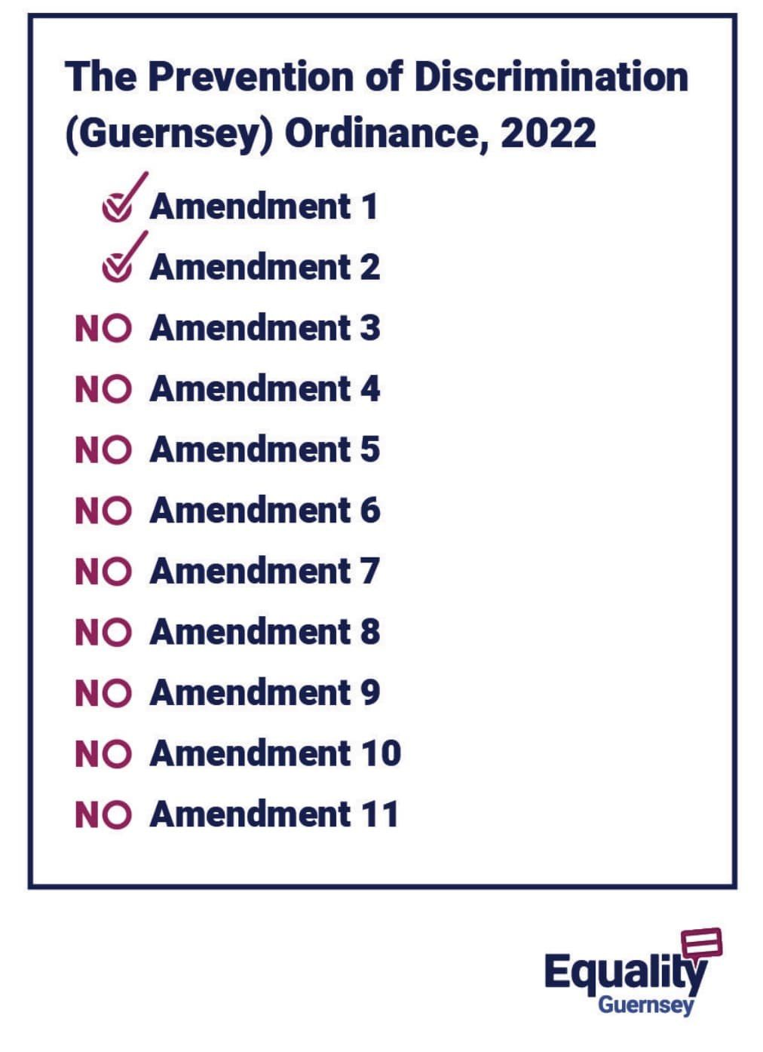
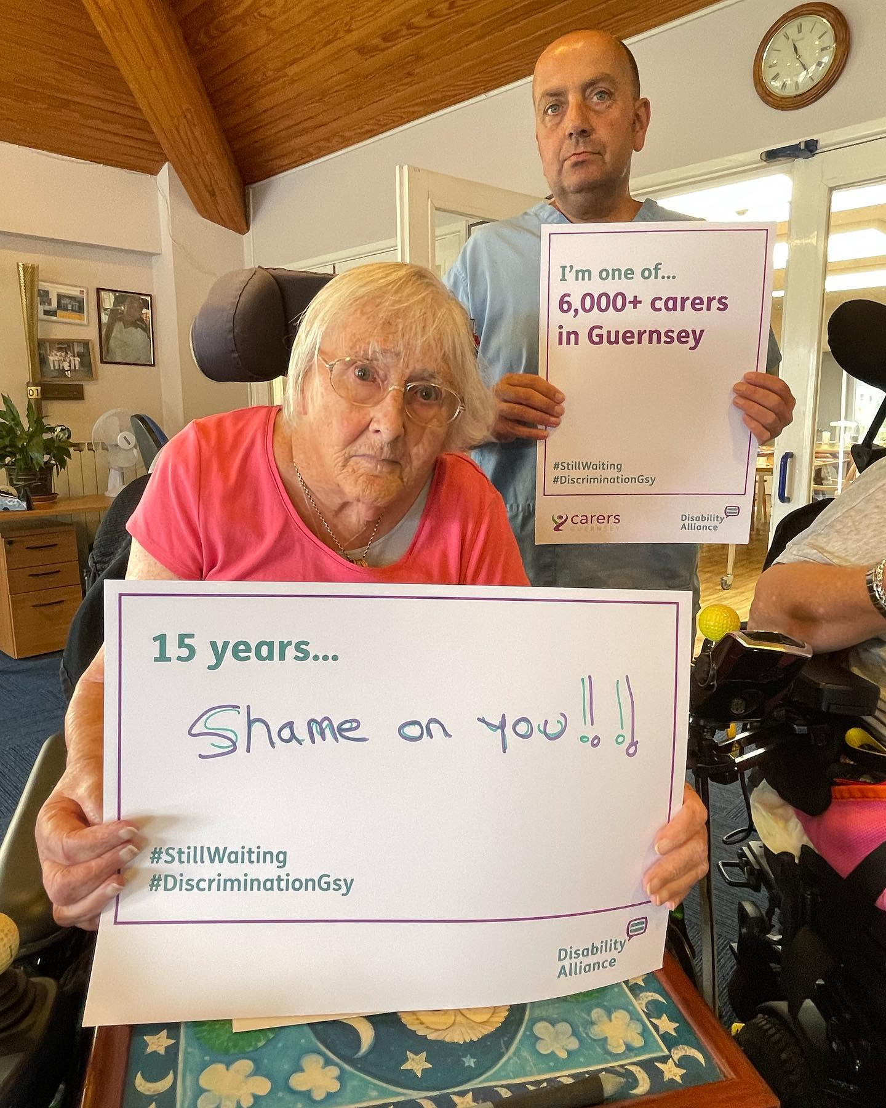
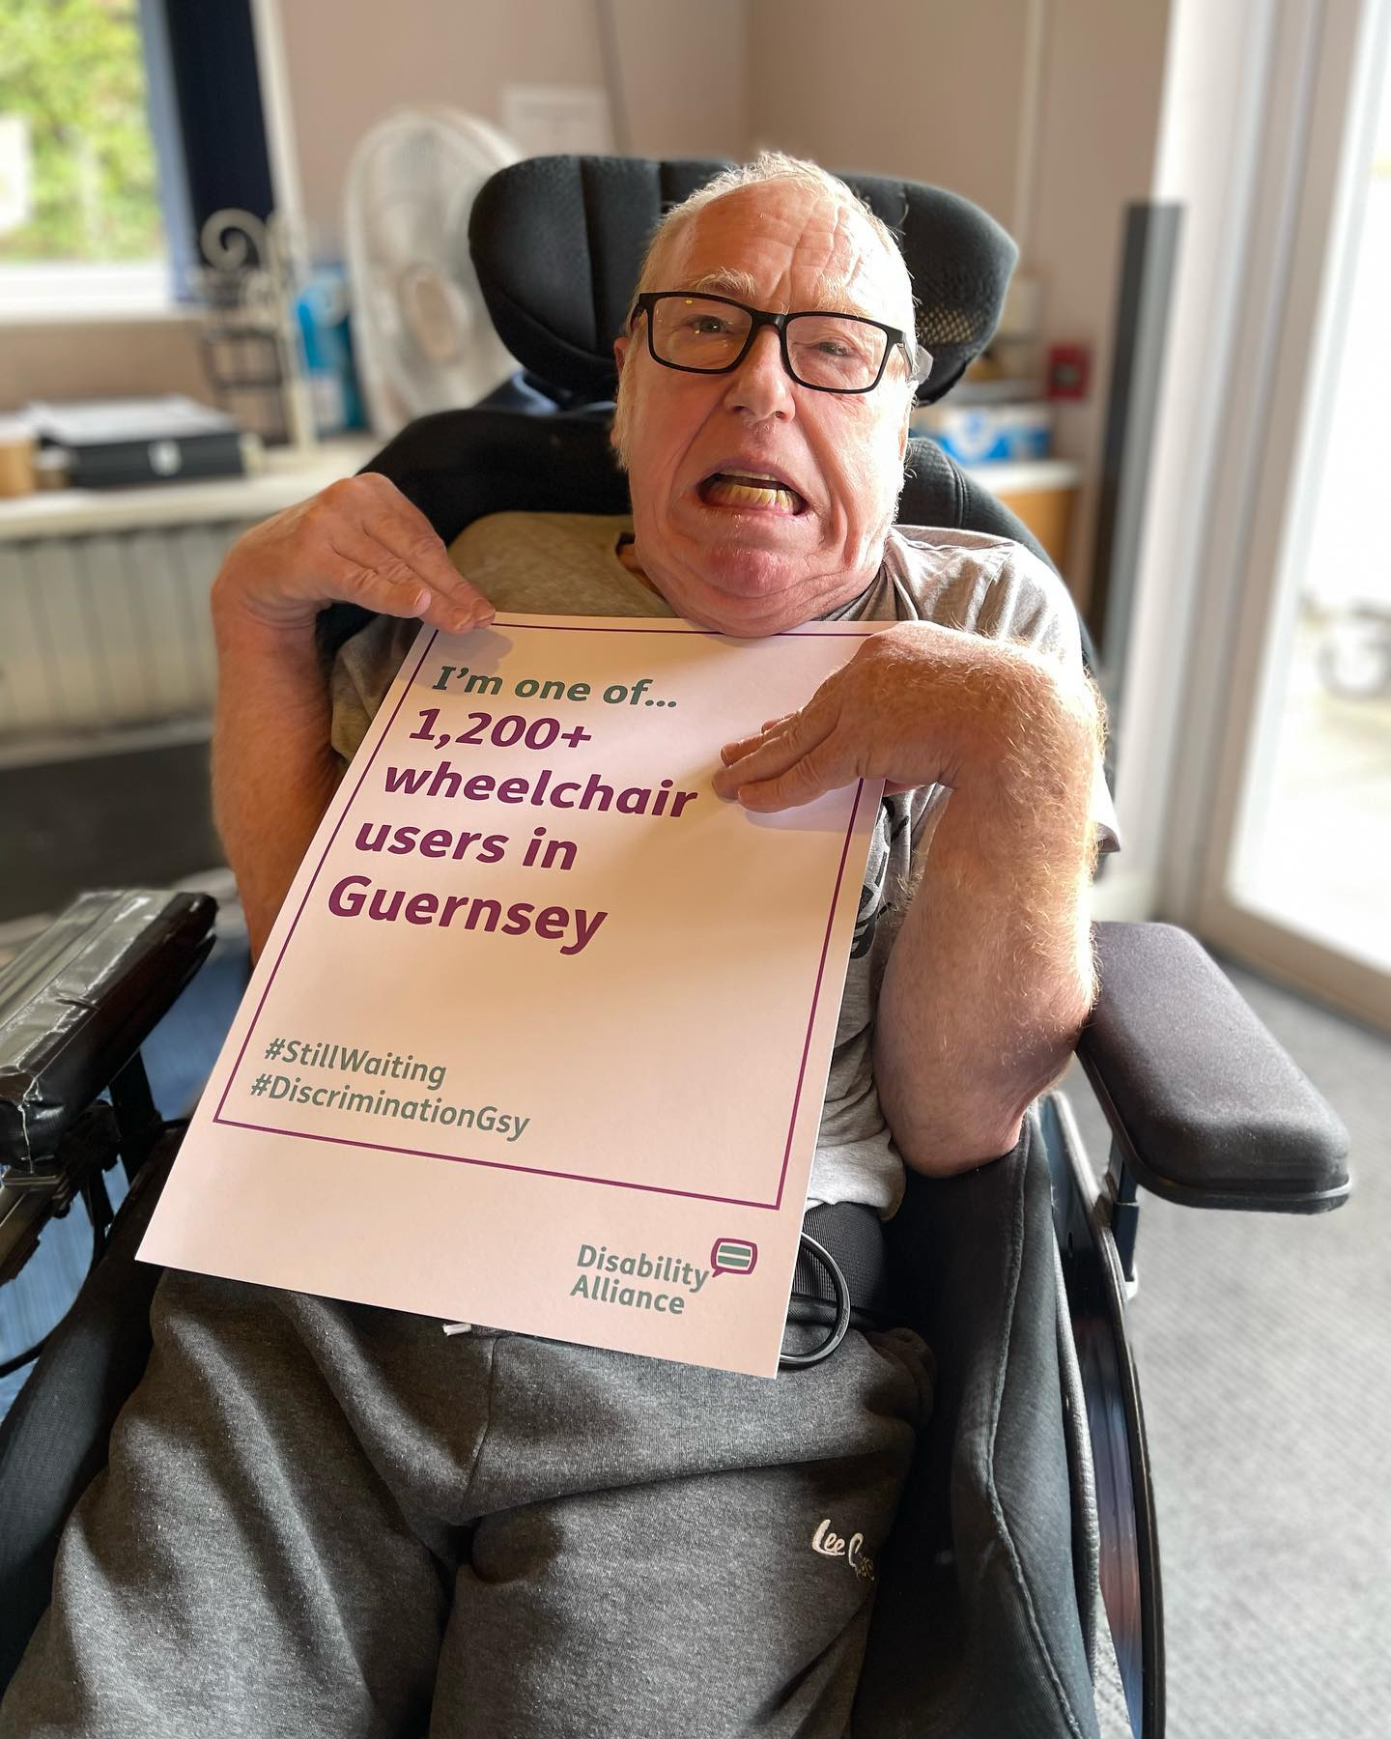
Thank you for all your support - before

Slide 9
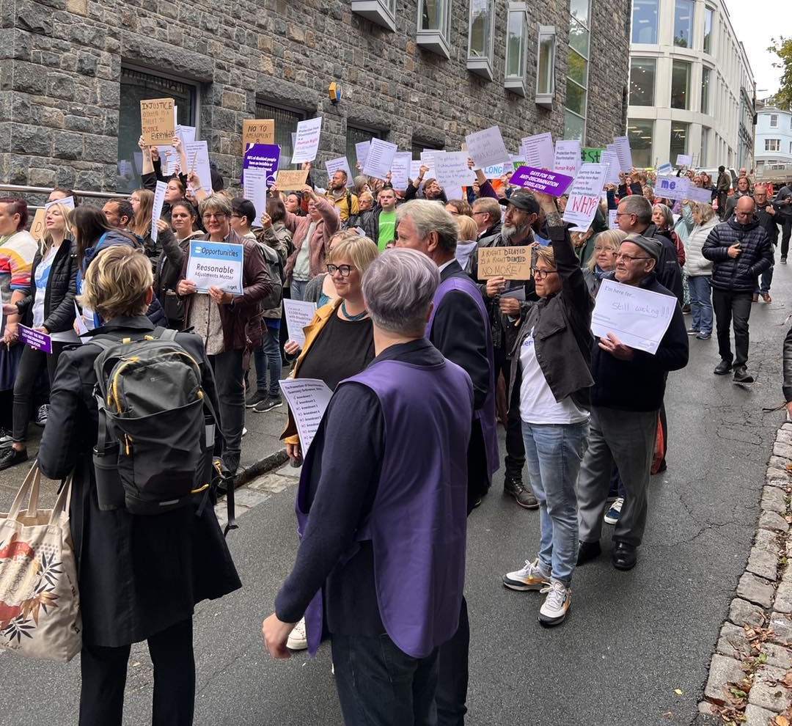
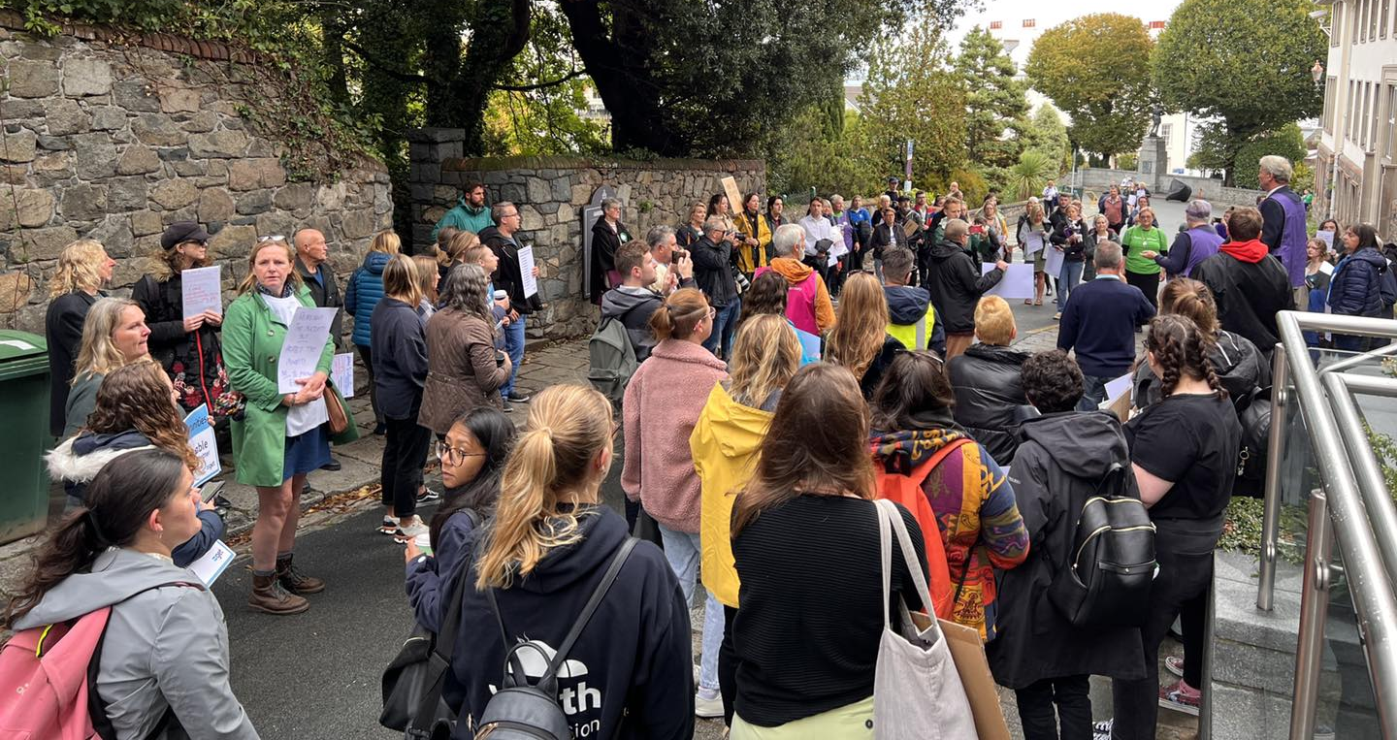
Thank you for all your support – on the day

Slide 10
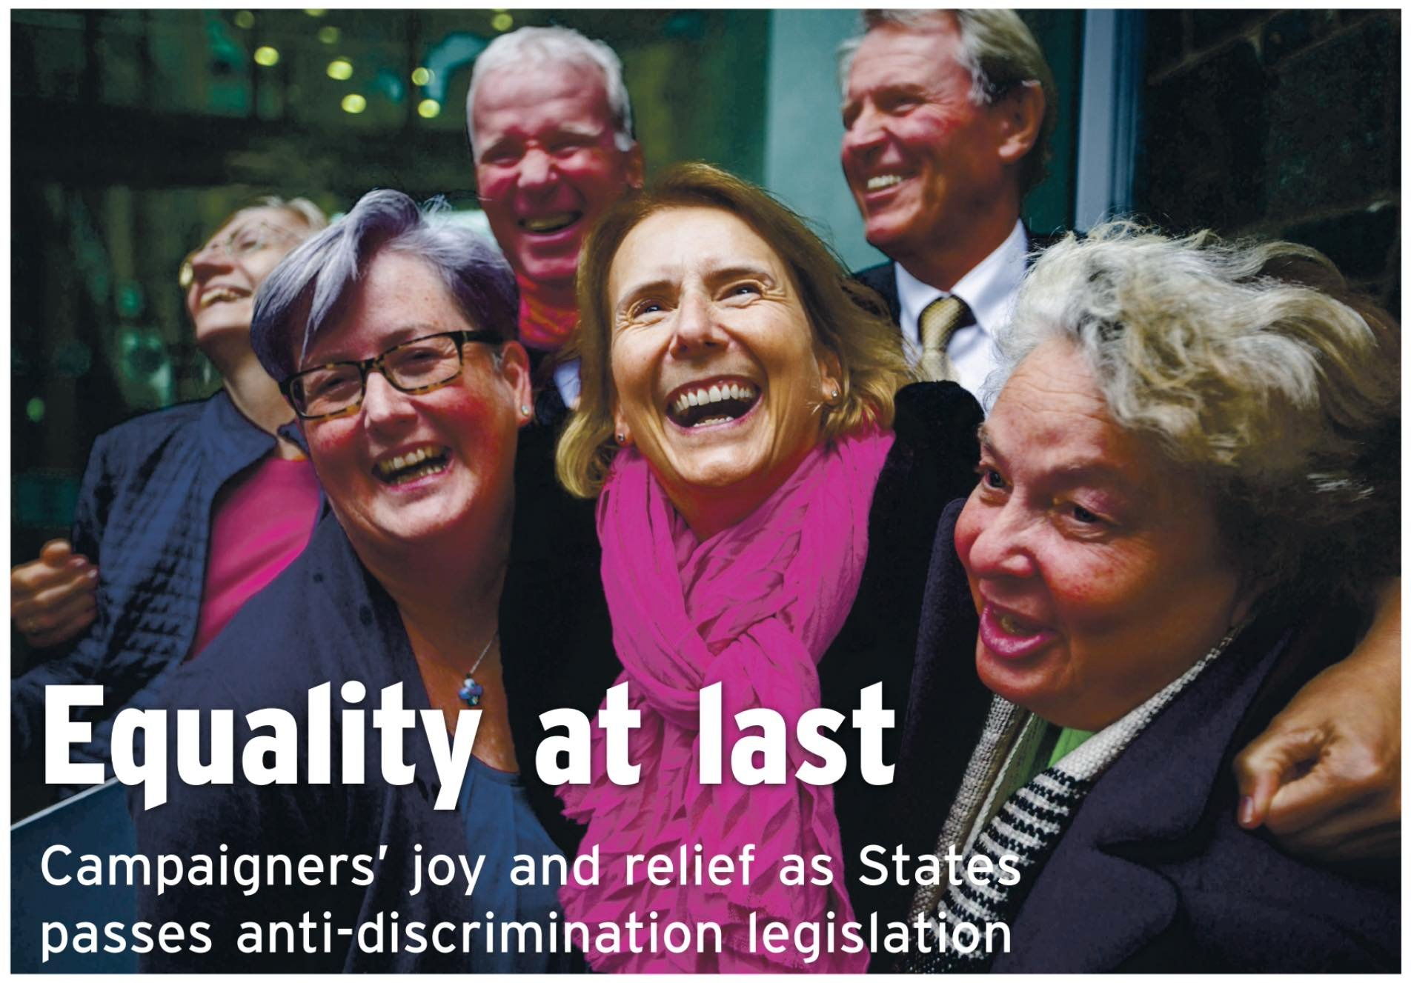
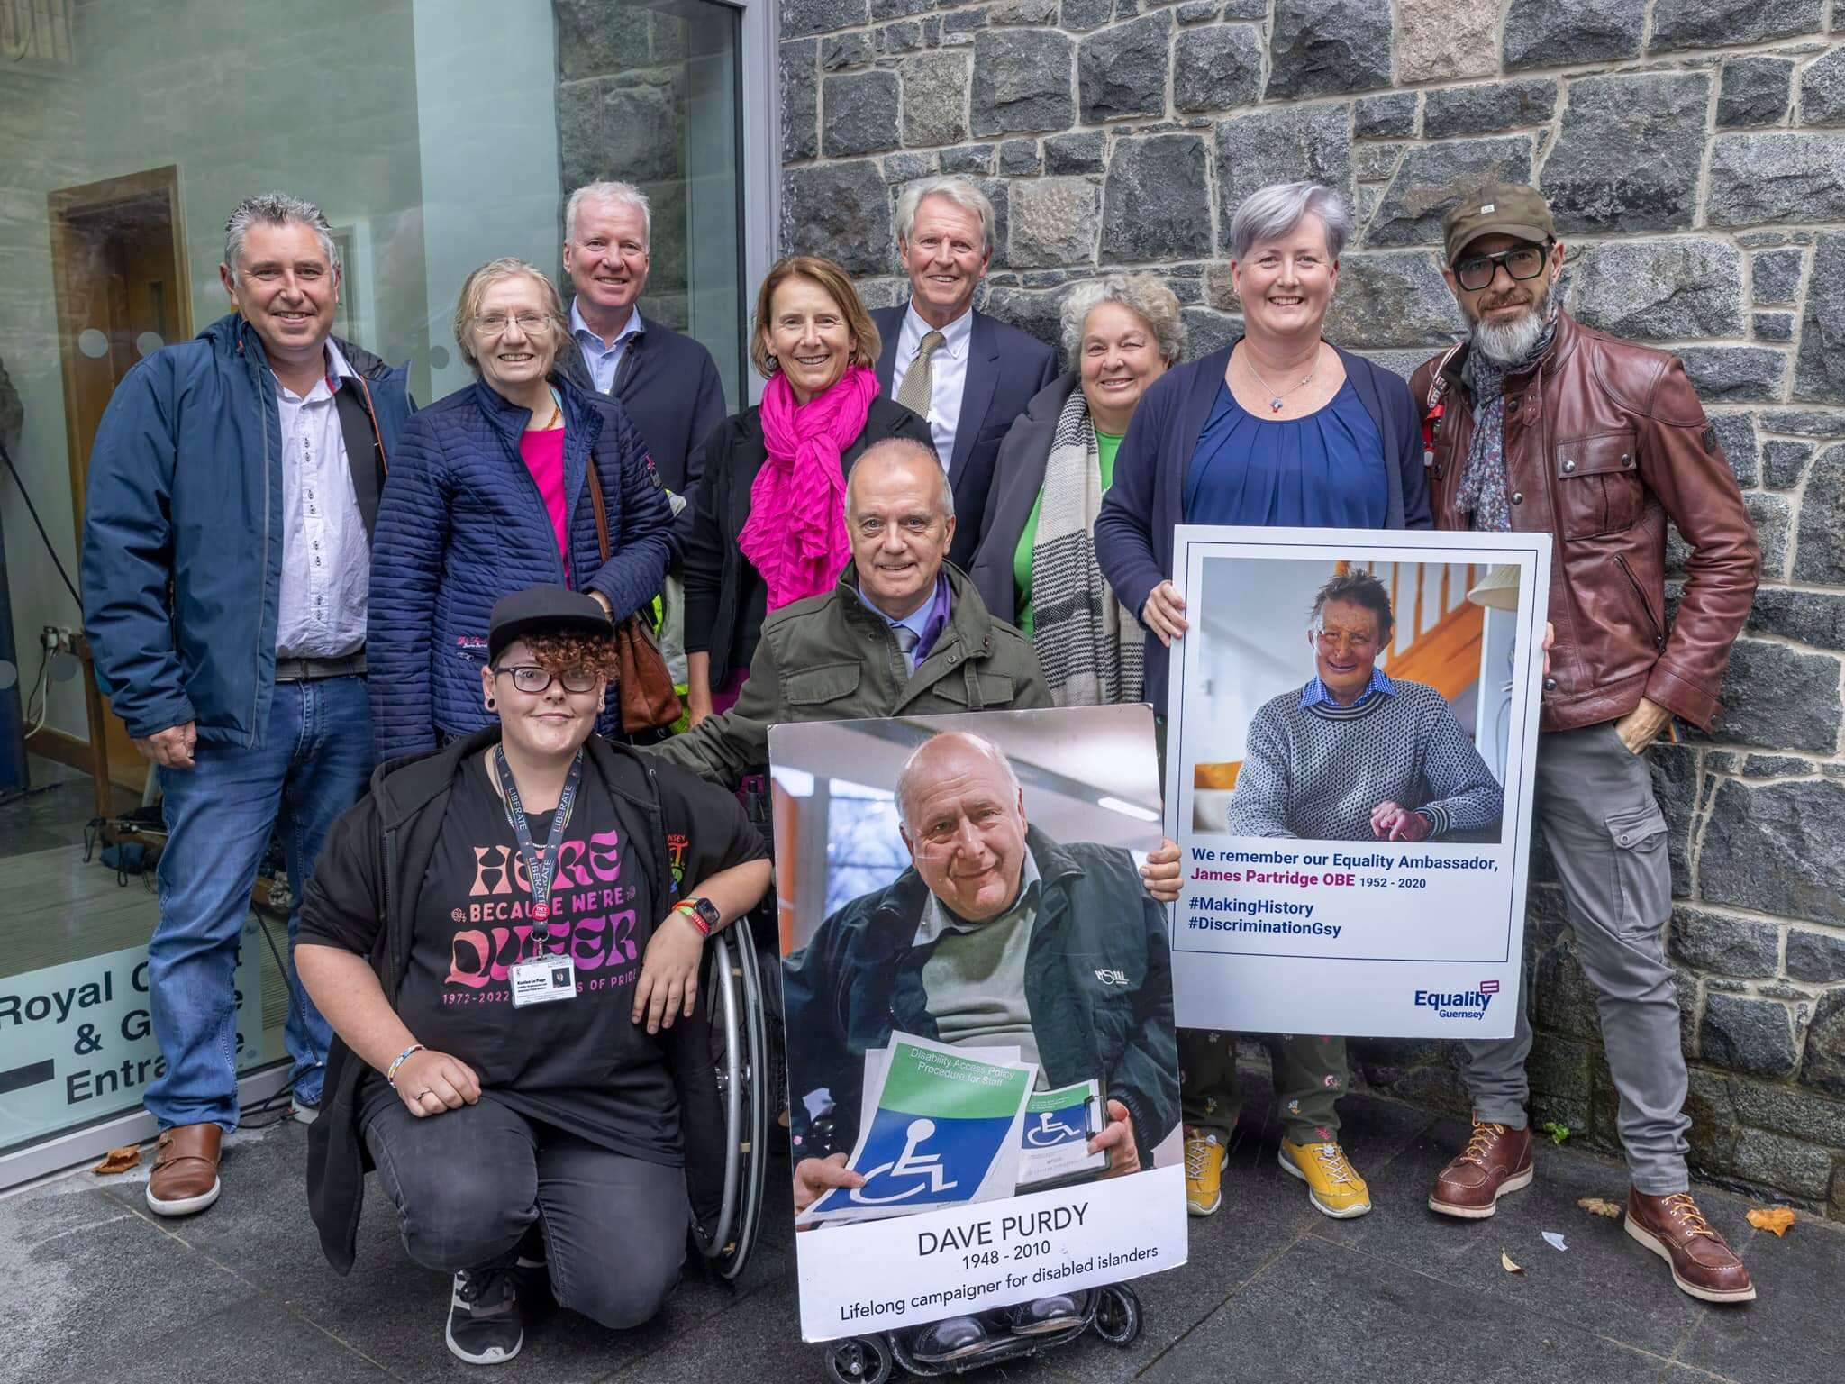
Yes!!!

Slide 11


Slide 12
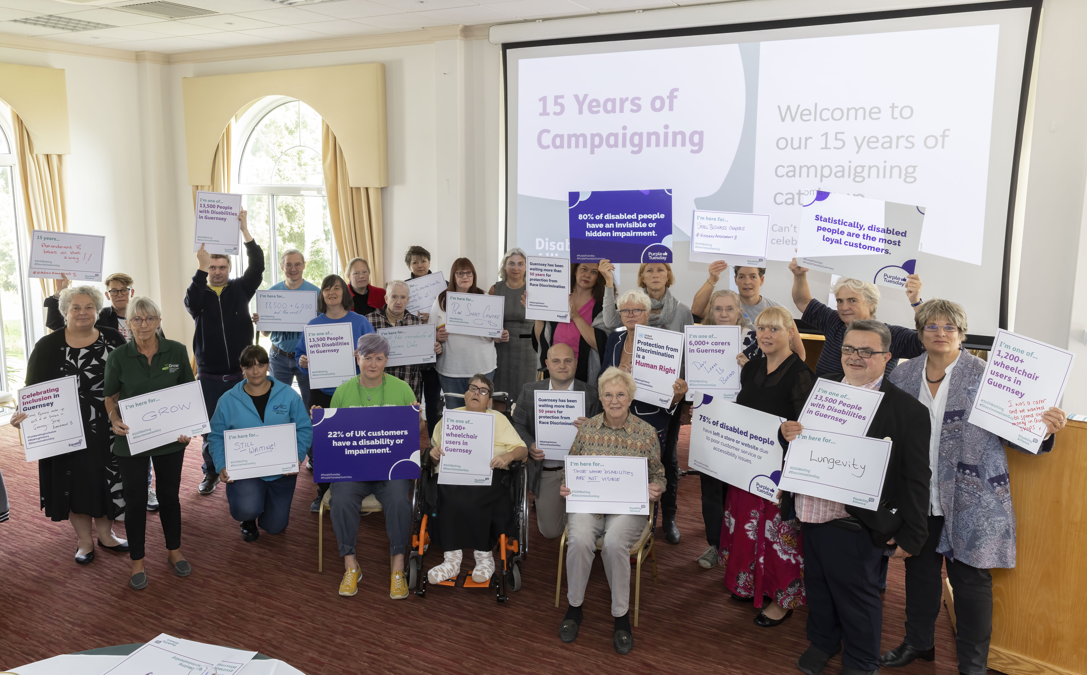

Slide 13
2022 was another great year in the community and raising awareness

Slide 14

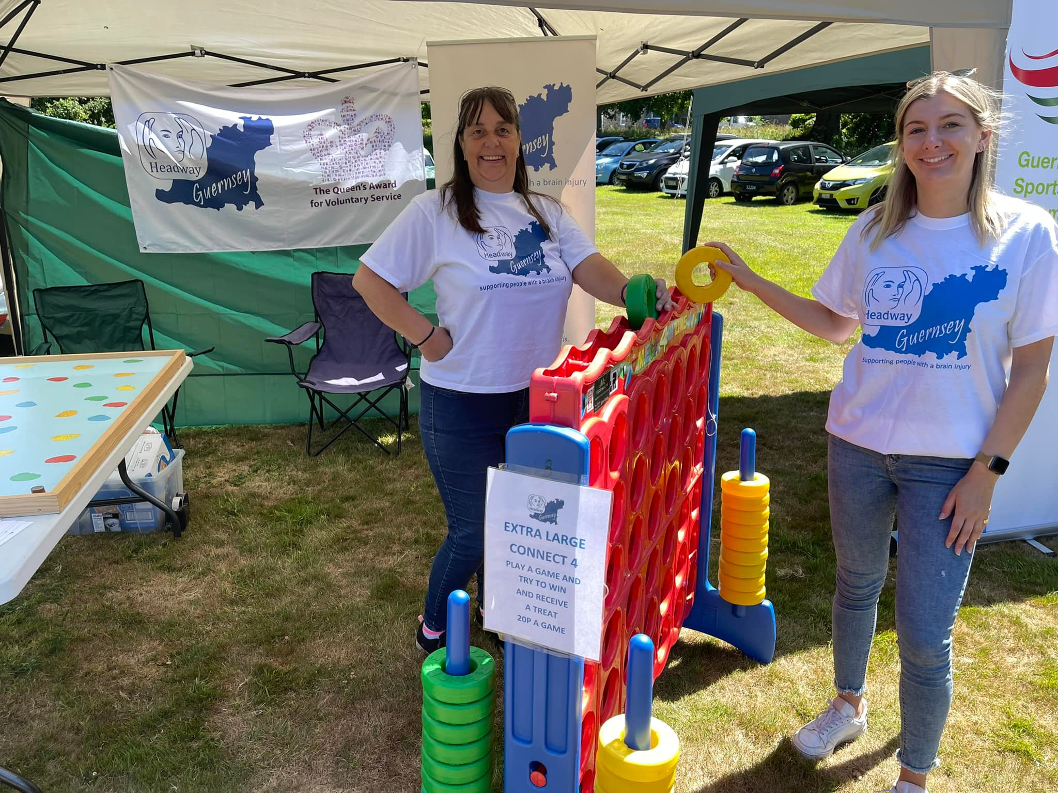

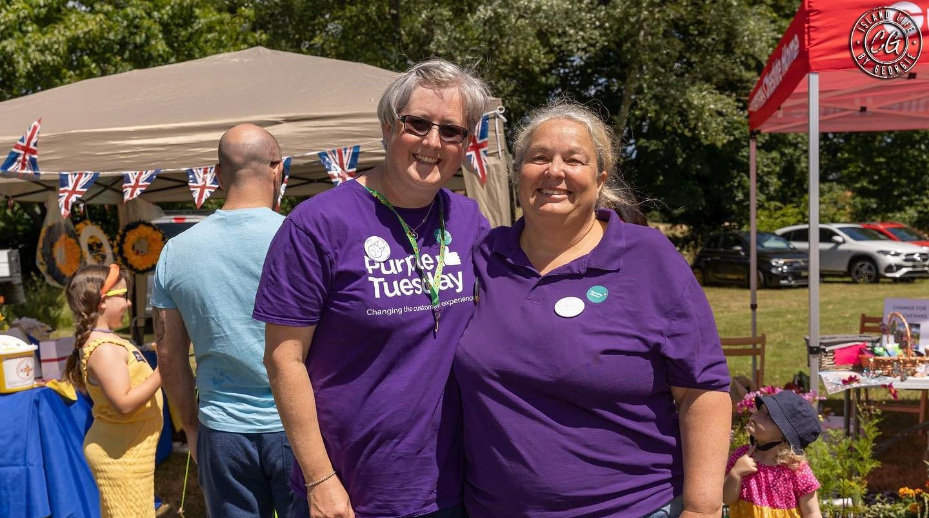

Slide 15
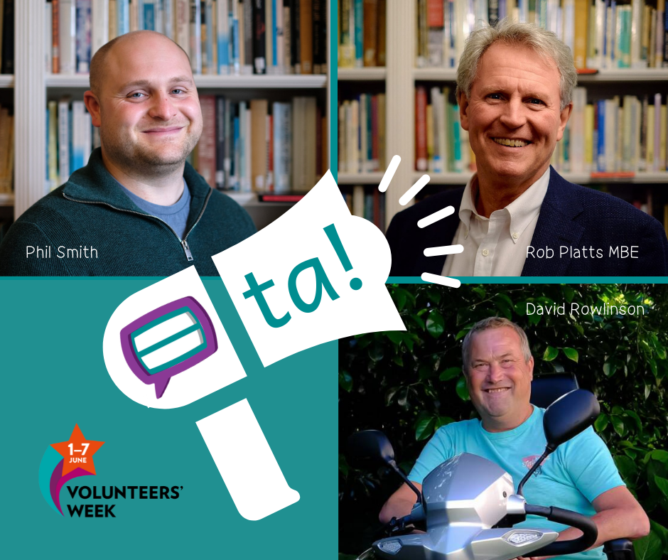

Slide 16
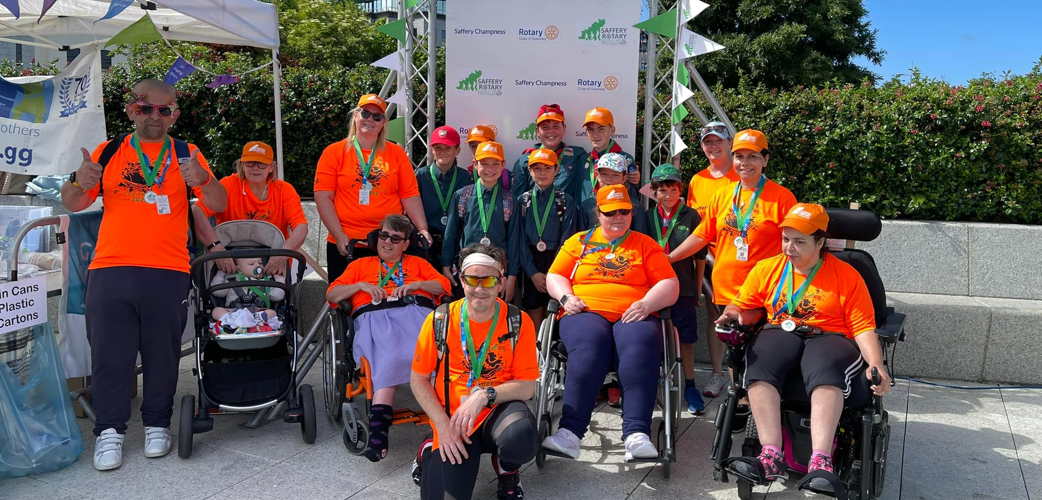

Slide 17


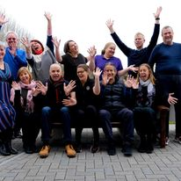
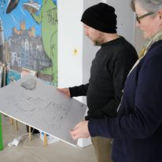

Slide 18
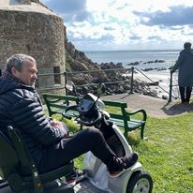
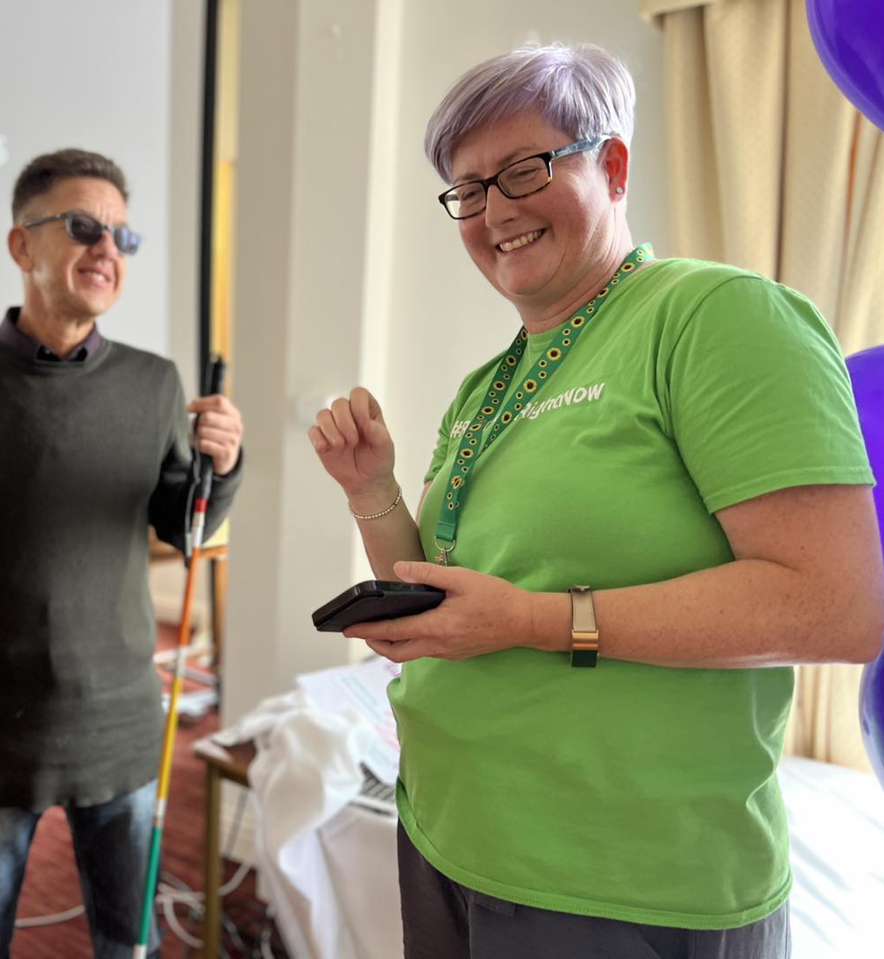

Slide 19
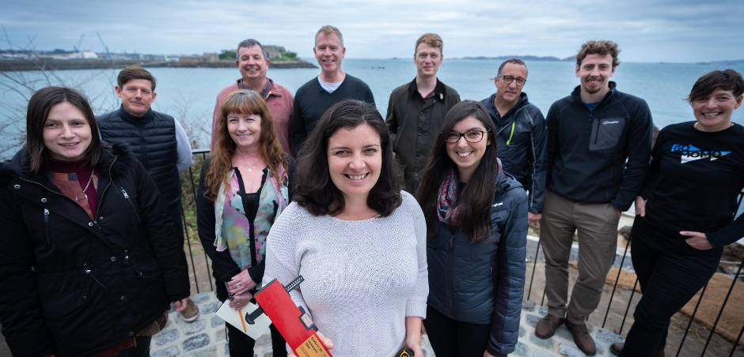
Notes:
https://youtu.be/4Zw0VVzK454

Slide 20


Slide 21
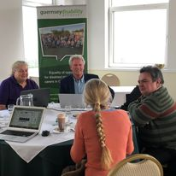
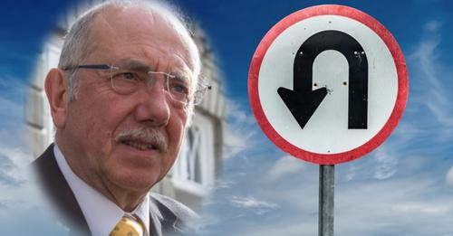
Social policy

Slide 22



Thank you to our funders

Slide 23
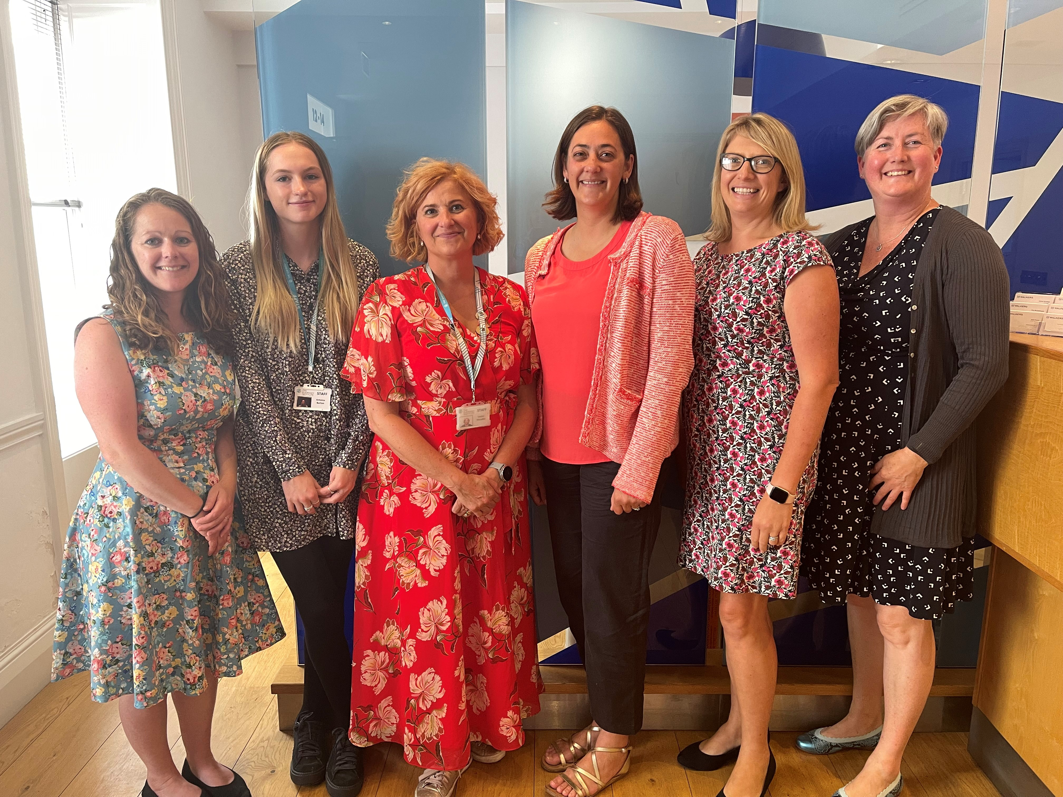


Slide 24
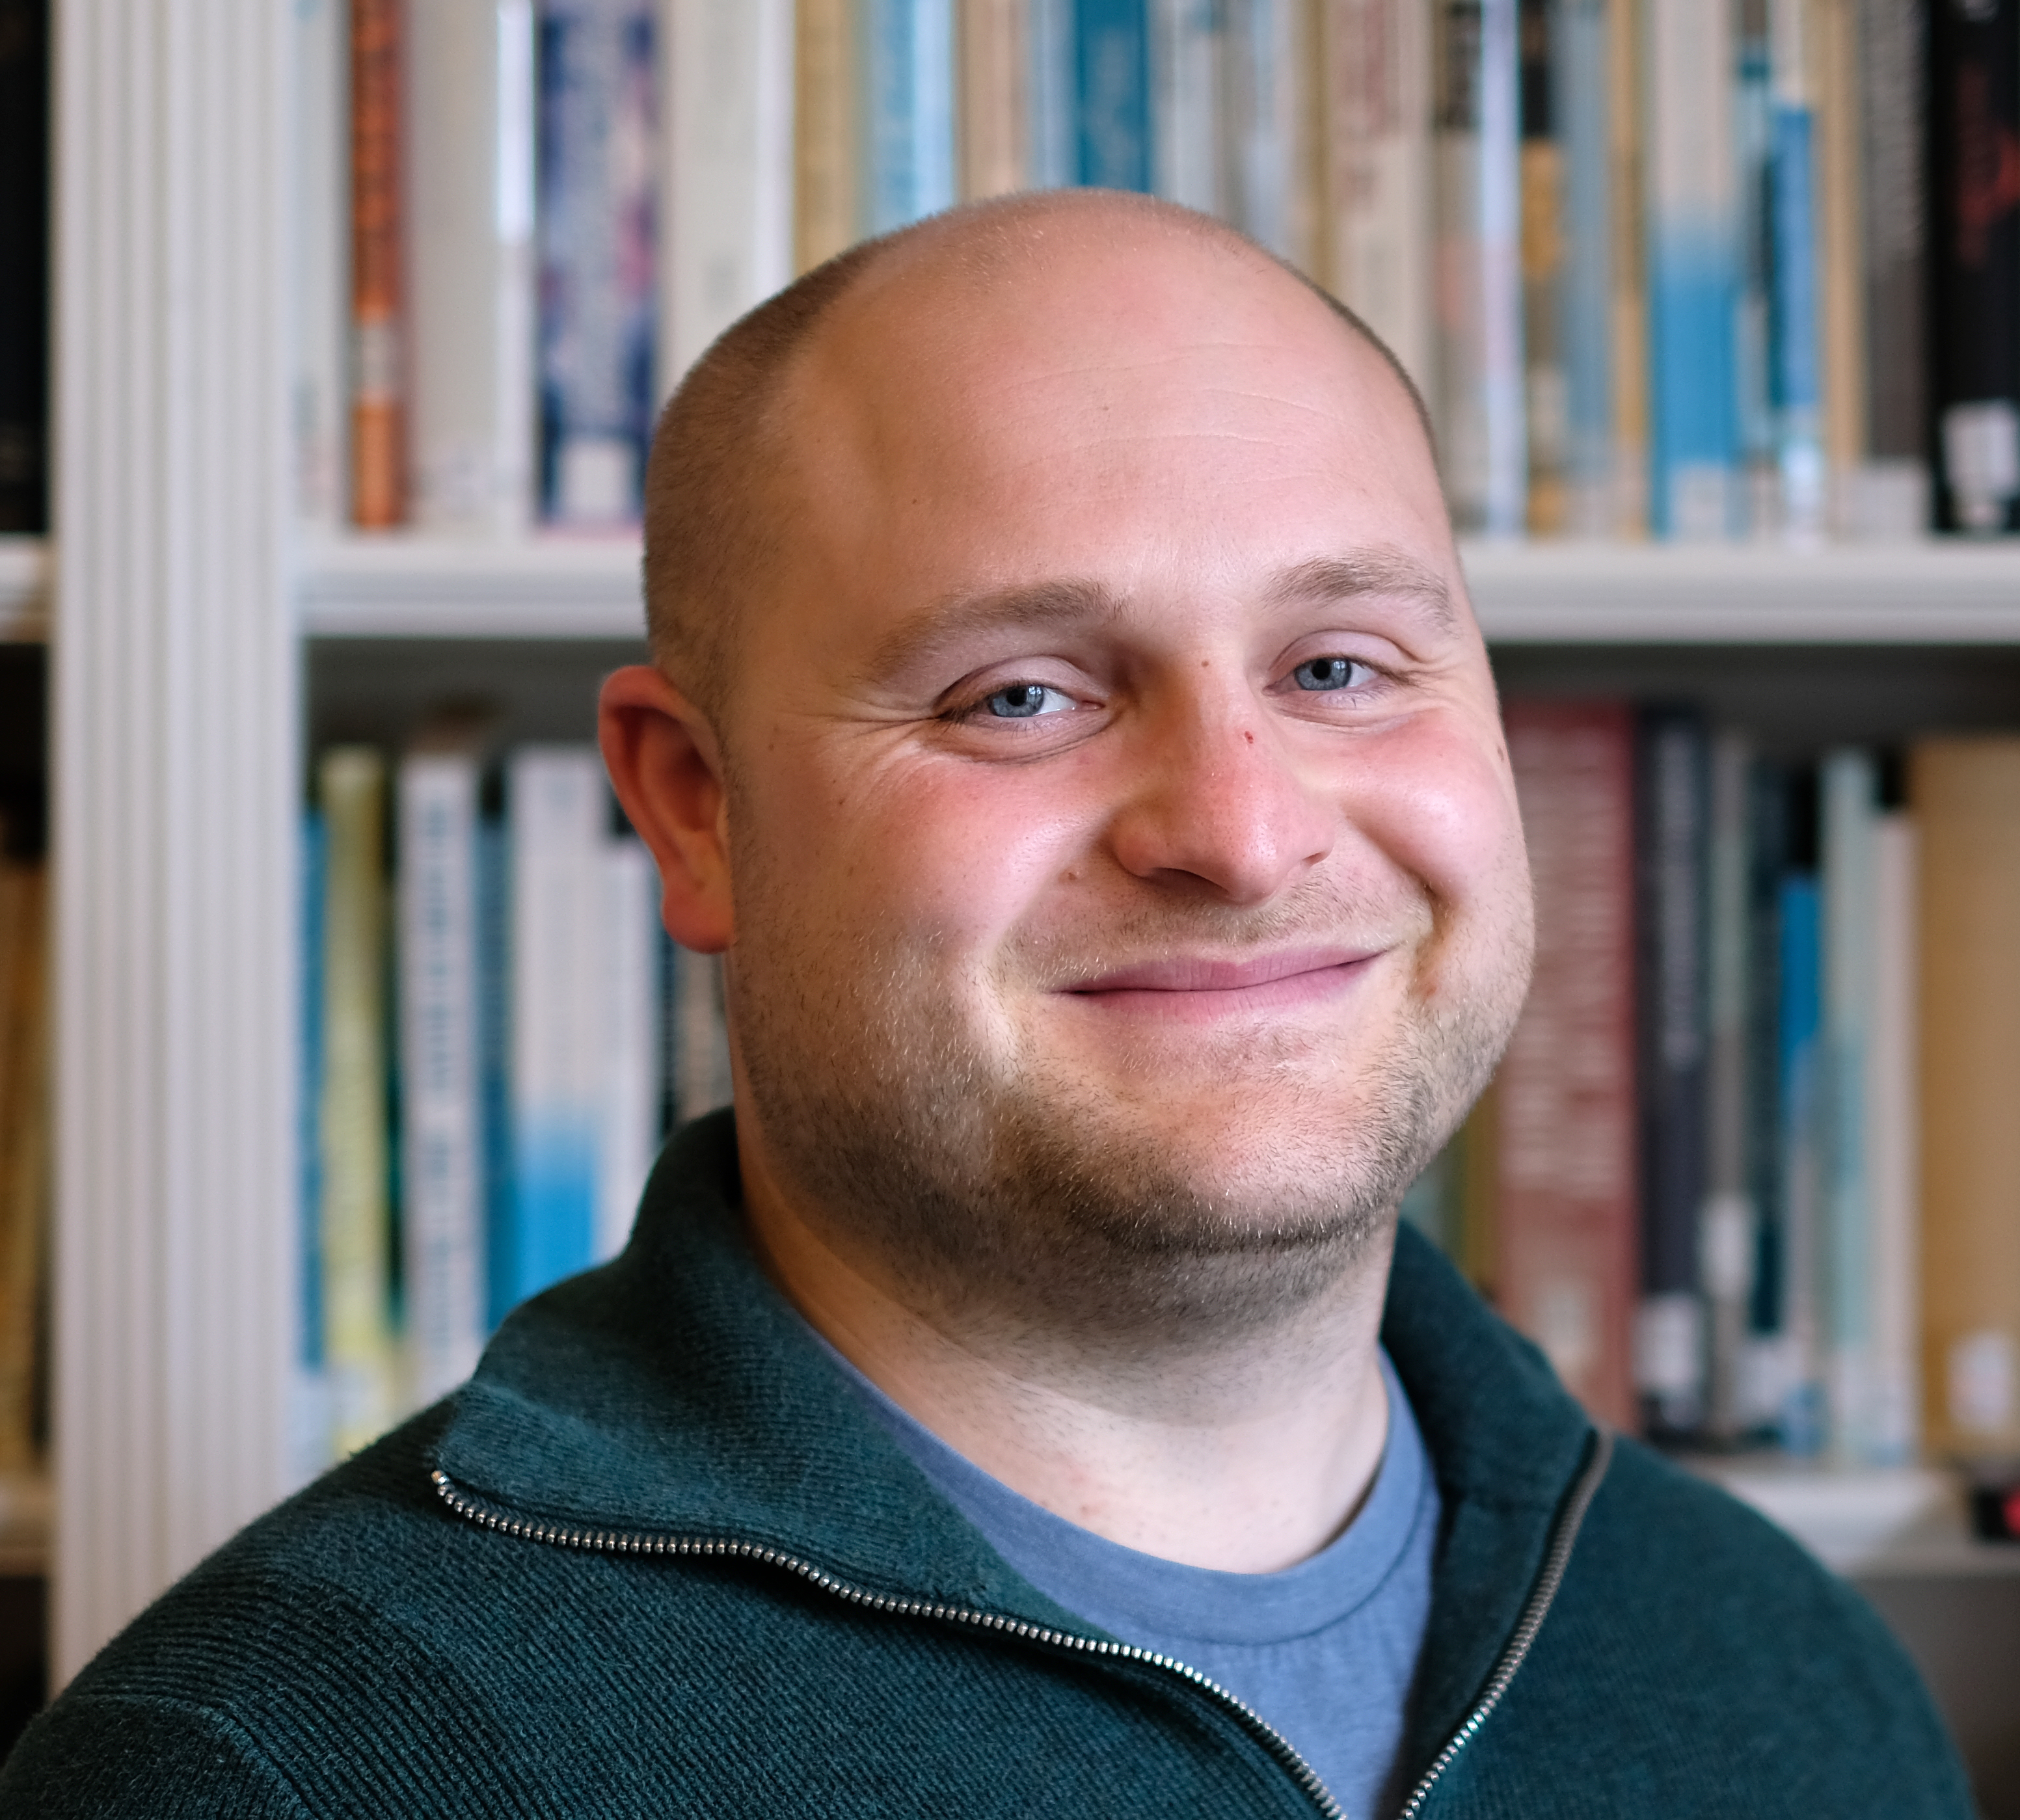
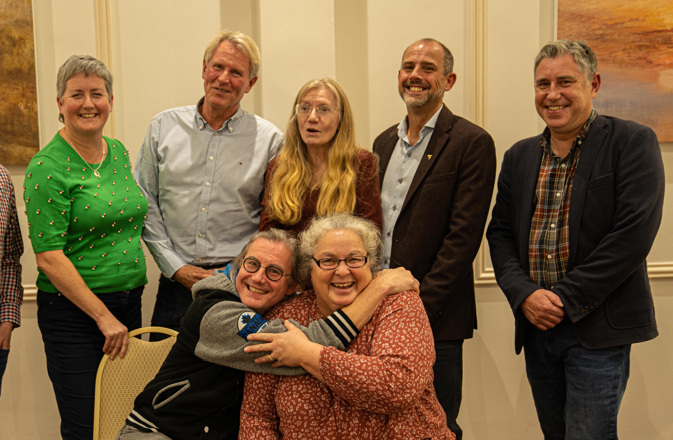
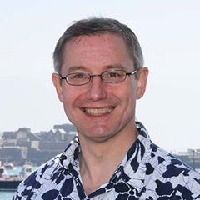
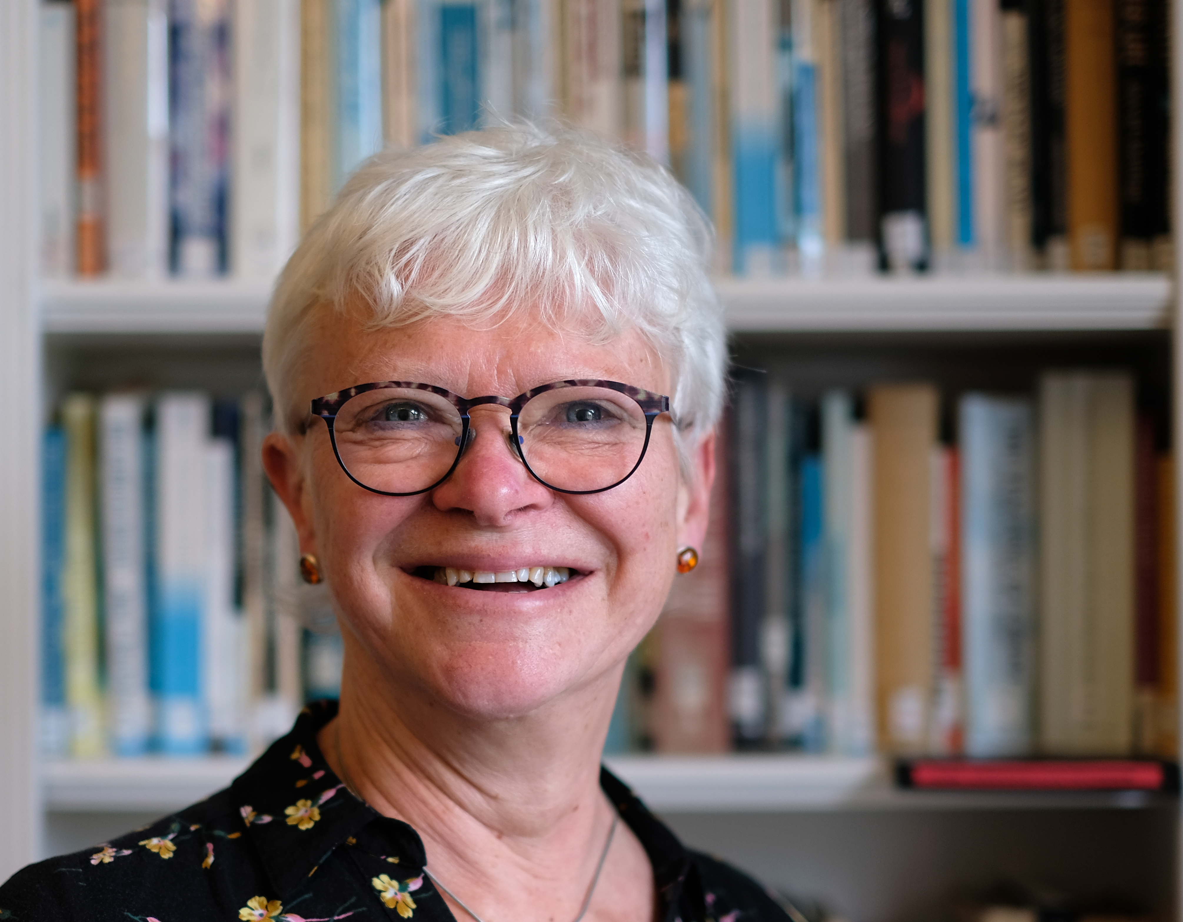
Thank you to our board and advisors

Slide 25
